Slide 1
COMP 4290
Week 2 - Friday

Slide 2
Last time
What did we talk about last time?
Biometrics
Tokens
Started access control

Slide 3
Questions?

Slide 4
Assignment 1

Slide 5
Project 1

Slide 6
Security tidbit of the day
AI hiring bots are growing common
To get a job at McDonald's, you might have to talk to their AI chatbot, Olivia
Some white hat hackers discovered that the password for the Paradox.ai account that runs Olivia was … "123456"
  (Not secure)
They accessed a database containing as many as 64 million chat records, many of which contained personal data
Follow the story:
  https://www.wired.com/story/mcdonalds-ai-hiring-chat-bot-paradoxai/

Slide 7
Back to Access Control

Slide 8
Extended Unix example
Unix has users, groups, and processes
A user has a unique UID
A group has a unique GID
A process has a unique PID
Each user can belong to many groups
Access is controlled on:
  Files
  Directories

Slide 9
File permissions
Reading
Writing
Executing
Ownership is also important

Slide 10
Directory permissions
Reading
Execution allows moving through the directory
Writing and executing are needed to create and delete files in a directory
There is also a "sticky bit" for directories
  If the sticky bit is set, only the directory owner can rename, move, or delete files owned by other people

Slide 11
Permission example
drwxr-xr-x
First character: directory or not
Next three characters: owner permissions
Next three characters: group permissions
Next three characters: other permissions

Slide 12
chmod example
We can change permissions using the Linux command chmod
Examples:
  chmod a+r wombat.txt
  chmod g+rw combat.txt
  chmod 664 ramjet.txt
Whoa! 664? What's that?
  Would it help if I pointed out that 664 can be written 110110100?

Slide 13
Role-based access control
Role-based access control makes an effort to abstract away from specific subjects
The idea is that you should have access based on your role
Examples:
  Secretaries have access to mailboxes
  Department heads have access to performance reports
  Provosts have access to salaries

Slide 14
RBAC definitions
A role is a collection of job functions
Each role is authorized to perform one or more transactions
The active role of a subject is the role that subject is currently performing
The authorized roles of a subject make up the set of roles that the subject is authorized to assume

Slide 15
Cryptography

Slide 16
Cryptography
"Secret writing"
The art of encoding a message so that its meaning is hidden
Cryptanalysis is breaking those codes

Slide 17
Encryption and decryption
Encryption is the process of taking a message and encoding it
Decryption is the process of decoding the code back into a message
A plaintext is a message before encryption
A ciphertext is the message in encrypted form
A key is an extra piece of information used in the encryption process

Slide 18
Notation
A plaintext is M (sometimes P)
A ciphertext is C
The encryption function E(x) takes M and converts it into C
  E(M) = C
The decryption function D(x) takes C and converts it into M
  D(C) = M
We sometimes specify encryption and decryption functions E_{k}(x) and D_{k}(x) specific to a key k

Slide 19
Attacks
Cryptography is supposed to prevent people from reading certain messages
Thus, we measure a cryptosystem based on its resistance to an adversary or attacker
Kinds of attacks:
  Ciphertext only: Attacker only has access to an encrypted message, with a goal of decrypting it
  Known plaintext: Attacker has access to a plaintext and its matching ciphertext, with a goal of discovering the key
  Chosen plaintext: Attacker may ask to encrypt any plaintext, with a goal of discovering the key
  Others, less common

Slide 20
Terminology
A sender S wants to send a message to a recipient R
If S gives the message to T who gives it to R, T is a transmission medium
If an outsider O wants to access the message (to read, change, or destroy it), we call O an interceptor or intruder
The fear is that O will cause one of the four security failures we discussed earlier:
  Blocking the message
  Intercepting the message
  Modifying the message
  Fabricating a false message

Slide 21
Terminology remix
The previous slide gives traditional, formal terminology
Rather than use letters, a system popularized by Ron Rivest is to use Alice and Bob as the two parties communicating
  Carl or another "C" name can be used if three people are involved
Trent is a trusted third party
Eve is used for an evil user who often eavesdrops
Mallory is used for a malicious user who is usually trying to modify messages

Slide 22
Encryption algorithms
The algorithms for encryption often rely on a secret piece of information, called a key
We can notate the use of a specific key in either of the two following ways:
  C = E_{K}(M)
  C = E(K, M)
In symmetric (or private key) encryption, the encryption key and the decryption key are the same
In asymmetric (or public key) encryption, the encryption key and the decryption key are different

Slide 23
Symmetric vs. asymmetric
Symmetric Encryption
Key K
Plaintext M
Encryption
Ciphertext C
Decryption
Plaintext M
Asymmetric Encryption
Encryption Key K_{E}
Decryption Key K_{D}
Plaintext M
Encryption
Ciphertext C
Decryption
Plaintext M

Slide 24
Cryptanalysts
A cryptanalyst is someone who is trying to break the cryptography and discover the plaintext or the key
A cryptanalyst could:
  Break a single message
  Find patterns in the encryption that allow future messages to be decrypted
  Discover information in the messages without fully decrypting them
  Discover the key
  Find weaknesses in the implementation of the encryption
  Find weaknesses in the encryption that may or may not be able to lead to breaks in the future

Slide 25
Cryptanalysis
There are two kinds of security for encryption schemes
  Unconditionally secure
    No matter how much time or energy an attacker has, it is impossible to determine the plaintext
  Computationally secure
    The cost of breaking the cipher exceeds the value of the encrypted information
    The time required to break the cipher exceeds the useful lifetime of the information
We focus on computationally secure, because there is only one practical system that is unconditionally secure
"I want them to remain secret for as long as men are capable of evil" -Avi from Cryptonomicon

Slide 26
Modular Arithmetic Overview

Slide 27
Review of Modular Arithmetic
Modulo operator takes the remainder
Two numbers are said to be congruent modulo n if they have the same remainder when divided by n
For example,
39 ≡ 3 (mod 12)
Addition, subtraction, and multiplication:
  [(a mod n) + (b mod n)] mod n = (a + b) mod n
  [(a mod n) – (b mod n)] mod n = (a – b) mod n
  [(a mod n) x (b mod n)] mod n = (a x b) mod n

Slide 28
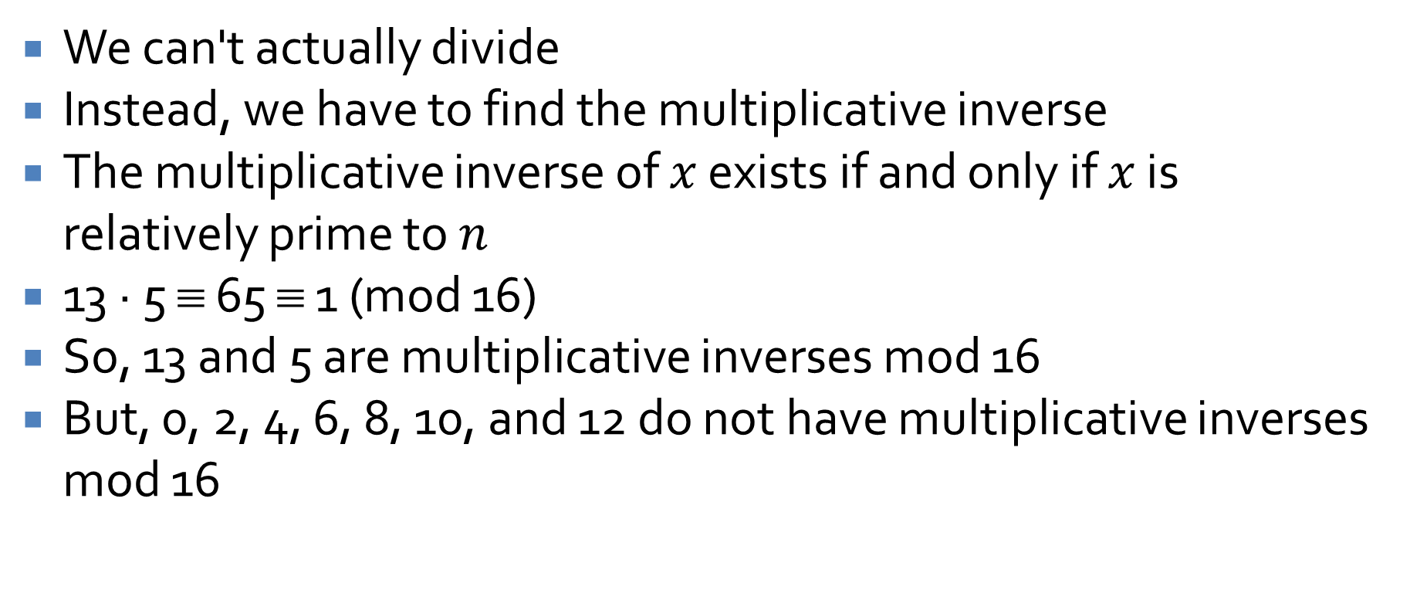
Divided and Conquered
We can't actually divide
Instead, we have to find the multiplicative inverse
The multiplicative inverse of $x$ exists if and only if $x$ is relatively prime to $n$
13 ∙ 5 ≡ 65 ≡ 1 (mod 16)
So, 13 and 5 are multiplicative inverses mod 16
But, 0, 2, 4, 6, 8, 10, and 12 do not have multiplicative inverses mod 16

Slide 29
Upcoming

Slide 30
Next time…
Shift ciphers
Substitution ciphers
One-time pads

Slide 31
Reminders
No class Monday!
Read Sections 2.3 and 12.1
Work on Project 1
Start Assignment 1
  Due next Friday

